Slide 1

W207 Applied Machine Learning Richard Huntsinger Division of Data Science & Information University of California, Berkeley Fall 2019

Slide 2
Agenda
Class Administration
Q&A
Types of Models: Classification, Regression
Model Optimization
Model Evaluation
Training, Development, & Test
Bias-Variance Trade-off
In-Sample, Out-of-Sample/Holdout, Cross-Validation
Feature Selection
Forward Selection
Backward Selection
Distance
K-Nearest Neighbors
Practice Quizzes
Performance on training data vs. test data
Test data for error analysis, repeated experiments
Distance calculations
Decision boundaries
Input space (i.e., number of possible observations)
Readings
Tutorial Notebooks: knn from scratch, knn from sklearn
More Q&A
Notes:
256 possible pixel values, 28 rows of pixels, 28 columns of pixels ➔ 256^{28x28} =

Slide 3
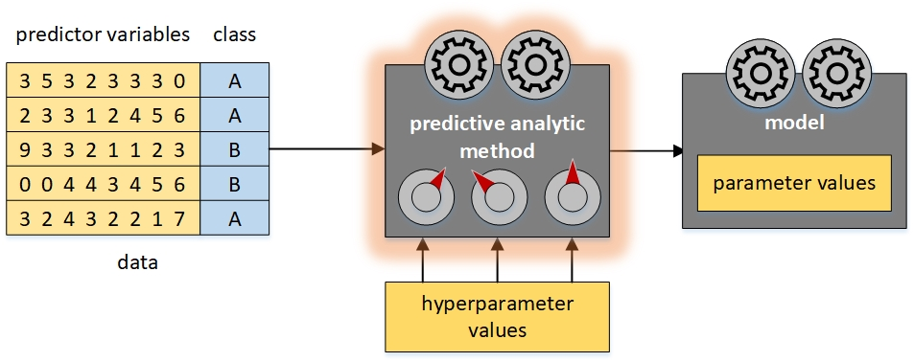
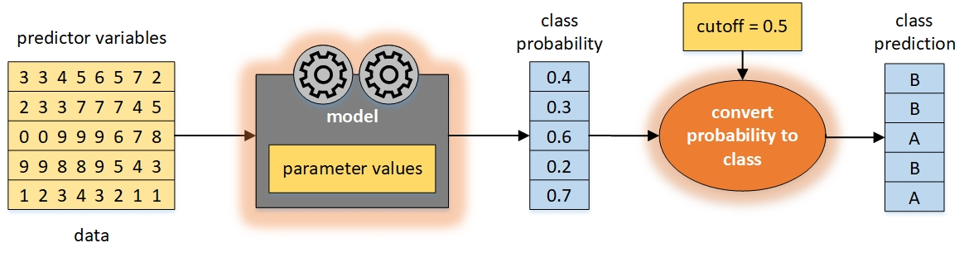
Classification
Train
Predict

Slide 4
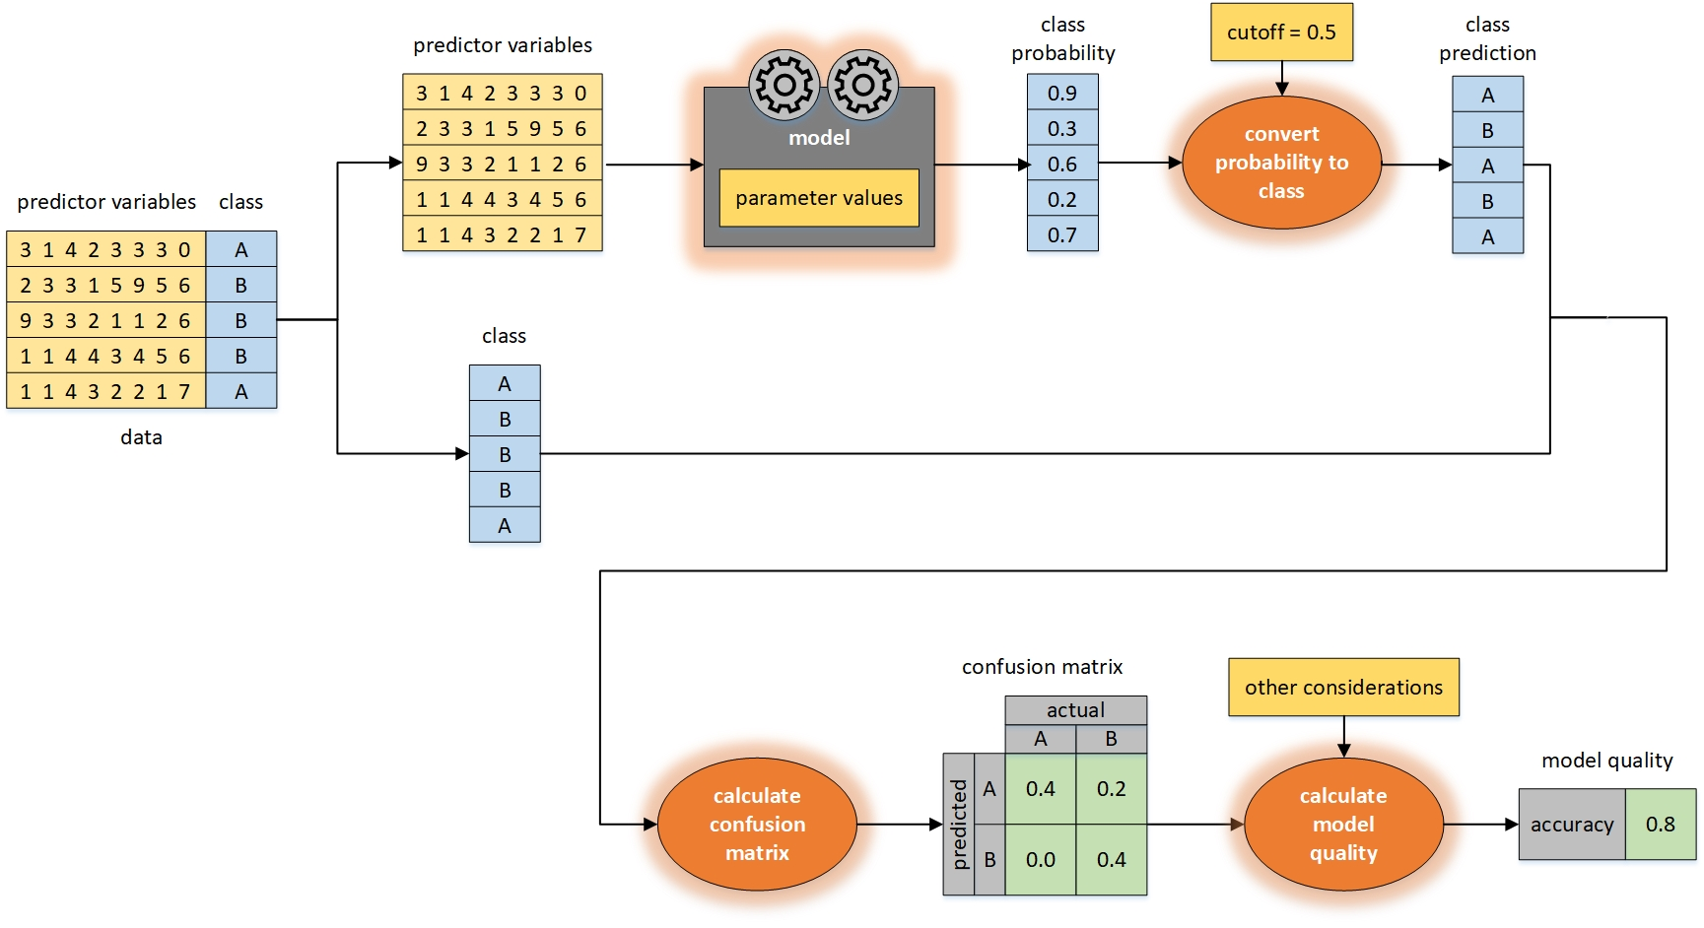
Classification
Evaluate

Slide 5
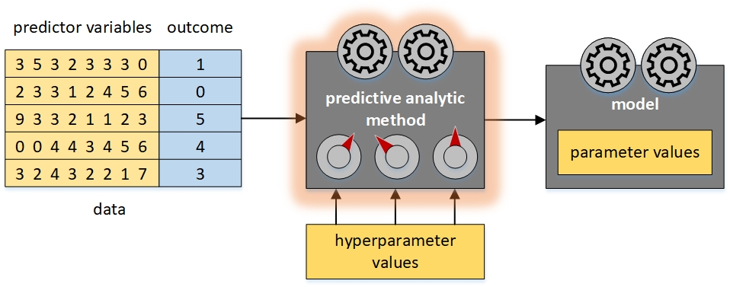
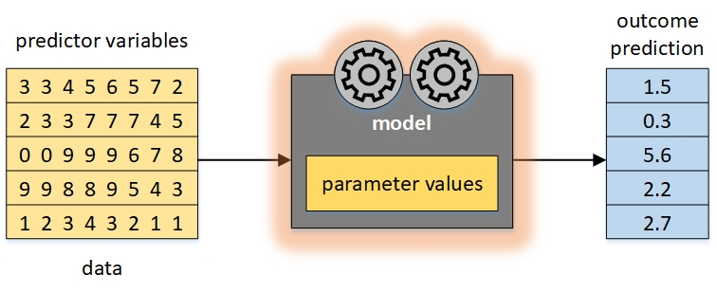
Regression
Train
Predict

Slide 6
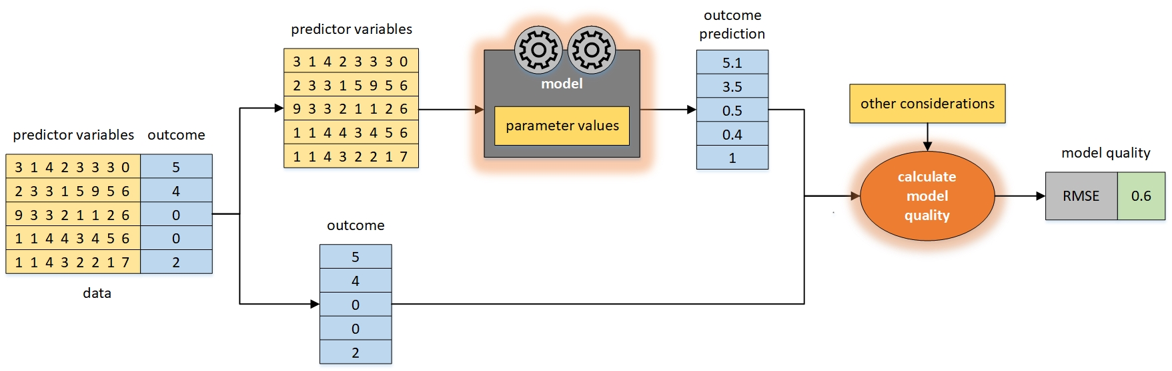
Regression
Evaluate

Slide 7
Model Optimization
Search for best data analytic method (type of model)
Search for best data
Search for best representation of data
Search for best variables
Search for best hyperparameter values

Slide 8
Model Evaluation
Training Data aka in-sample data
Used to build a model
Directly involved in building a model
Development Data aka out-of-sample data
Used to evaluate a model’s ability to make good predictions, and to then adjust the model or compare models
Better estimate of real model performance
Indirectly involved in building a model
Test Data
Used to evaluate a model’s ability to make good predictions
Best estimate of real model performance
Not involved in building a model
Beware of Overfitting
Does model predict training observations well, but predict development/test observations poorly?
Notes:
Skit: 3 datasets, 2 methods, 2 models

Slide 9
Model Evaluation
Training data & development data
To reduce risk of overfitting
training data
use model based on training data to predict development data
development data
estimated performance of model

Slide 10
Model Evaluation
Training data, development data, & test data
To reduce risk of overfitting & to optimize model
2 candidate models
2 candidate models
training data
use model based on training data to predict development and test data
use model based on training data to predict validation and testing data
development data
testing data
estimated performance of best model
compare models
compare models

Slide 11
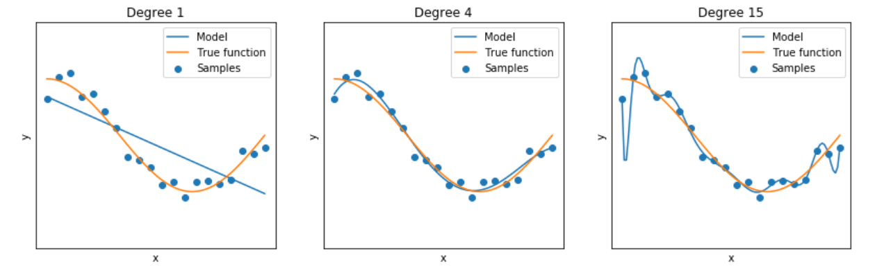
Bias/Variance Tradeoff
variance↓ bias↑ ➔ underfit
variance↑ bias↓ ➔ overfit

Slide 12
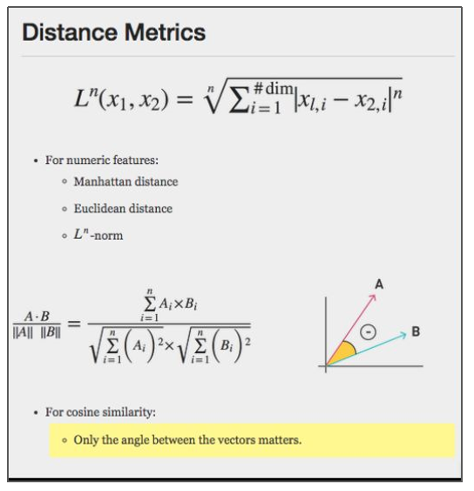
Distance / Dissimilarity
Manhattan Distance (L1)
Euclidean Distance (L2)
Cosine Distance = 1 – Cosine Similarity https://www.machinelearningplus.com/nlp/cosine-similarity/
Hamming Distance
see notebook: distance.ipynb

Slide 13
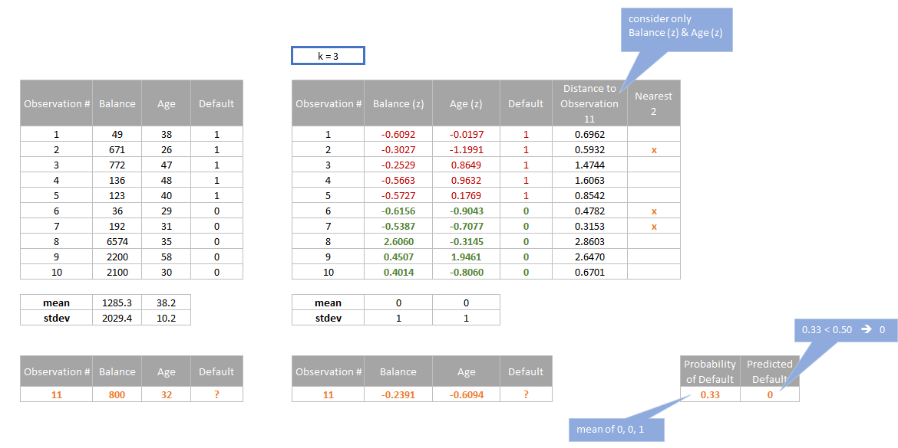
k-Nearest Neighbor - classification
3

Slide 14
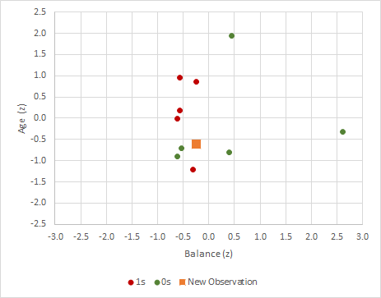
k-Nearest Neighbor - classification

Slide 15
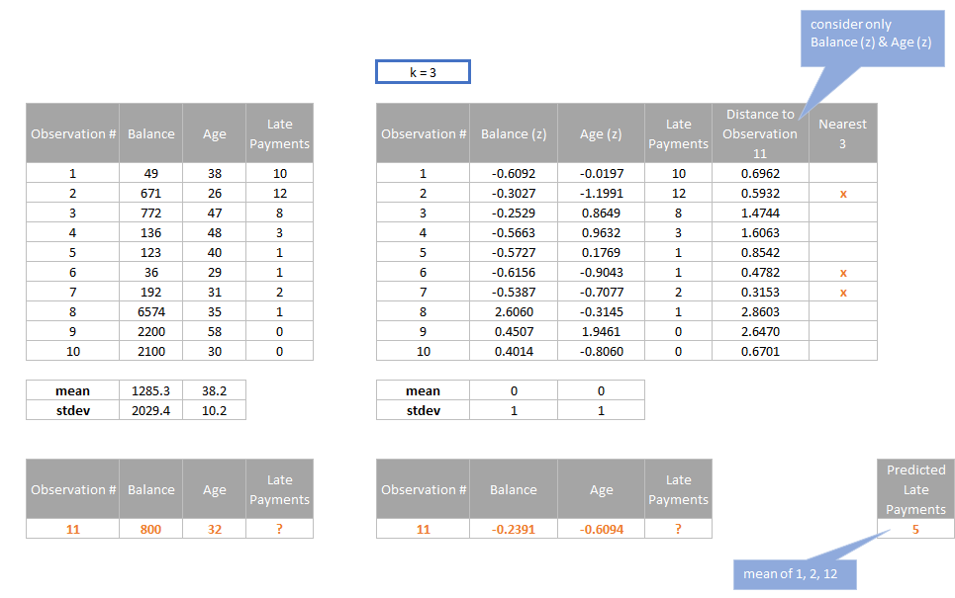
k-Nearest Neighbor - regression

Slide 16
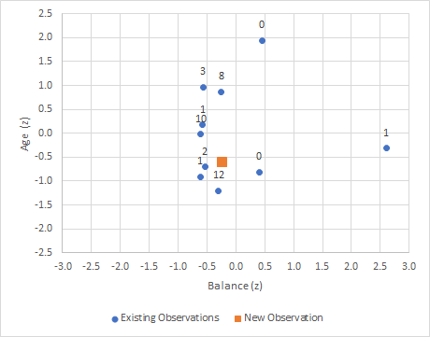
k-Nearest Neighbor - regression

Slide 17
Reading
The Unreasonable Effectiveness of Data (Halevy, Norvig, Pereira)
Cargo Cult Science (Feynman)
Rules from experts vs. Rules from data
Problems:
representation, model encoding, inference/prediction
Authors’ advice:
Choose representation for unsupervised learning
Choose non-parametric model
No new variables
How to test a model?

Slide 18
Reading
A Few Useful Things to Know About Machine Learning (Domingos)
The Problem of Overfitting (Hawkins)
Components of Machine Learning Method:
Representation (of the data, of the model)
Evaluation
Optimization (of the hyper-parameters, of the parameters)
Generalization:
True/False, number of words → 2¹⁰⁰⁰⁰⁰ possible inputs to classify
Overfitting
Curse of Dimensionality:
Many variables → Small fraction of input space
Theoretical Guarantees
Deductive: model → predictions → observations → confirmation
Inductive: observations → pattern → model
Feature Engineering
Data vs Method
Causality vs Correlation
Prediction vs Effect Quantification
Overfitting
Cross-Validation
Extrapolation
Measures of Fit

Slide 19
Tutorials
K-Nearest Neighbor
see notebooks: Nearest Neighbors.ipynb, KNN Notebook – norms and errors.ipynb

